Slide 1


# Prediction
We want to use a computer program to help doctors predict heart disease. The program will analyze health data like age and blood pressure. It then attempts to predict whether a person has heart disease or not.

Slide 2

# Prediction
We want to help doctors find out if a person might have heart disease using a computer program. The program will look at health data and then guess if that person has heart disease or not.

Slide 3

# kNN Algorithm
KNN (K-Nearest Neighbors) is like asking your closest friends what they think. Let's say you are not sure if someone likes pizza. So, you ask their closest friends what they like. If most friends say "yes", you guess this person also loves pizza.
KNN does the same thing. It looks at the closest people in the data and sees what they had. Then it makes a guess.

Slide 4
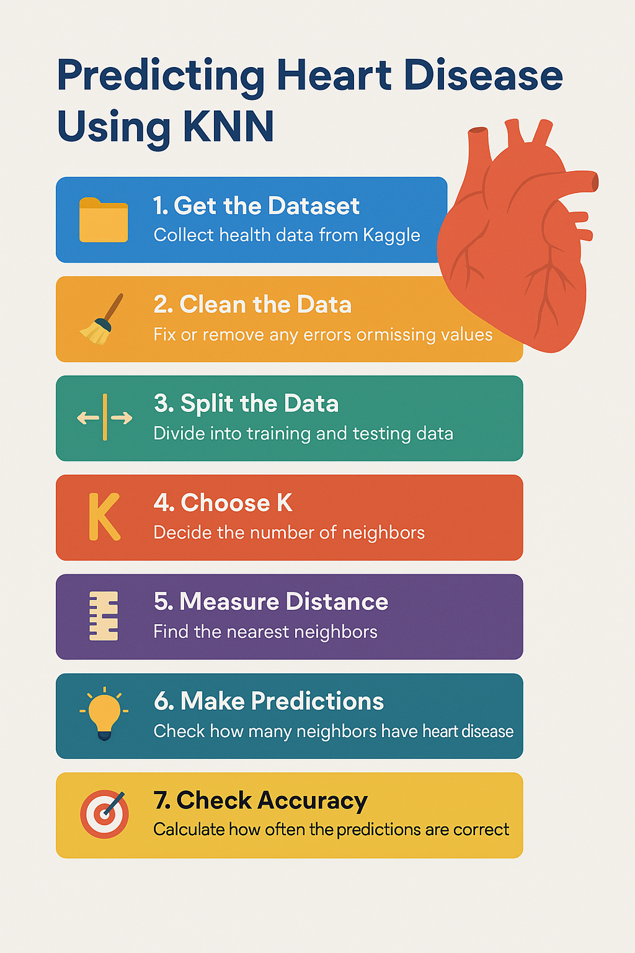

Slide 5
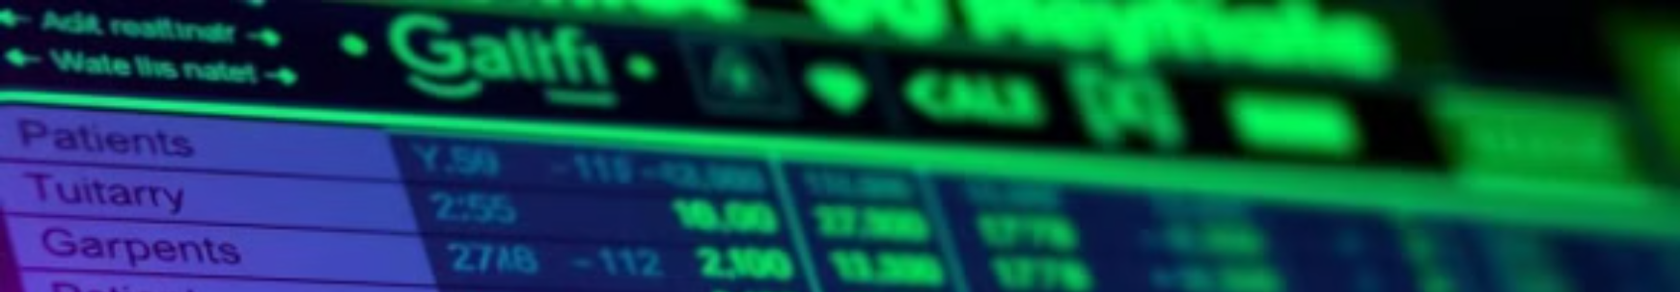
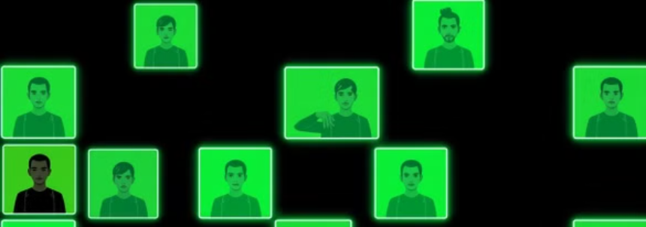

# Step-by-Step Process
1. Get the Dataset
We collect a file from Kaggle which has health records.
This file is like a big Excel sheet with rows and columns.
Each row = One person Each column = A health detail (like age, blood pressure, sugar level...) The last column says if the person has heart disease (Yes or No, or 1 or 0)

Slide 6

# 2. Clean the Data
2. Clean the Data
Sometimes the data may have: Empty spots (Missing Values)
We need to fix or remove them
so our program doesn't get confused.

Slide 7
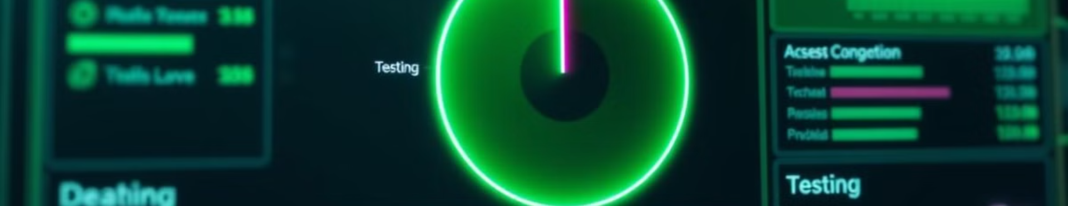
# 3. Split the Data
3. Split the Data
We divide the data into two parts: Training Data: For teaching the computer (like school learning)
Testing Data: For checking how well it learned (like a school test)
Example: 80% for training, 20% for testing.

Slide 8

# 4. Choose K
4. Choose K (the number of neighbors)
We pick a number K, like 3 or 5.
This means the computer will look at the 3 or 5 closest people in the data to guess.

Slide 9

# 5. Measure Distance
5. Measure Distance
The computer checks who is closest using numbers, like how far apart they are in age, BP, etc.
This is done using math formulas like Euclidean distance (just like measuring closeness).

Slide 10

# 6. 🤖 Make Predictions
6. 🤖 Make Predictions
For a new person: It checks the K nearest people in the training data. It sees how many had heart disease.
If most of them had it → It guesses Yes If most did not → It guesses No

Slide 11

# 7. 🏁 Check Accuracy
7. 🏁 Check Accuracy
We check if the computer guessed correctly using the test data. We calculate:
Accuracy = How many guesses were correct out of total guesses

Slide 12
Coding...

Slide 13
import pandas as pd
from sklearn.model_selection import train_test_split
from sklearn.neighbors import KNeighborsClassifier
from sklearn.metrics import accuracy_score
# Step 1: Load the data
data = pd.read_csv("heart.csv") # You get this from Kaggle

Slide 14
# Step 2: Split into inputs and target
X = data.drop('target', axis=1) # All columns except the answer
y = data['target'] # This is the answer (0 or 1)

Slide 15
# Step 3: Train-Test Split
X_train, X_test, y_train, y_test = train_test_split(X, y, test_size=0.2)
# Step 4: Create KNN model
model = KNeighborsClassifier(n_neighbors=5)
# Step 5: Train the model
model.fit(X_train, y_train)

Slide 16
# Step 6: Make predictions
predictions = model.predict(X_test)
if predictions ==1:
print(“heart disease”)
else:
print(“no heart disease”)
# Step 7: Check accuracy
accuracy = accuracy_score(y_test, predictions)
print("Accuracy:", accuracy)

Slide 17
Thank you

